Slide 1
Update from NIAMS
SPARTAN Annual Meeting: Cambridge, MA
May 5, 2018
James Witter MD, PhD FACR
PROMIS & CSO PEPR & Project Scientist ECHO
Medical Officer/Rheumatic Diseases Clinical Program-(Extramural)
National Institute of Arthritis and Musculoskeletal and Skin Diseases (NIAMS)
Patient-provider-personal ‘rheumatologic’ perspective & ideas

Slide 3
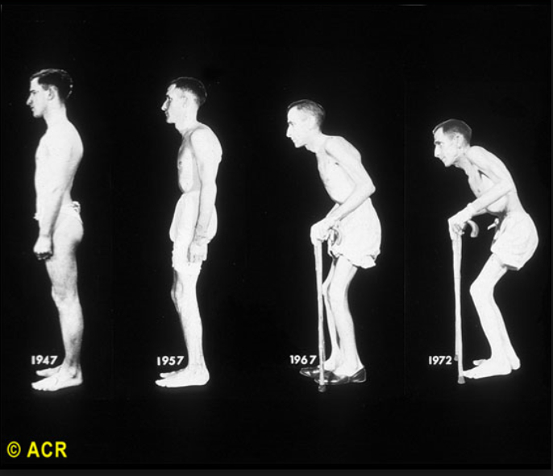

Slide 4
Conceptualizing Health & Disease:
Different approaches to multi-morbidity
DOMAIN
(universally relevant-agnostic)
vs.
DISEASE
(attributable)

Slide 5
What is Health?
1948 WHO definition:
  a state of complete physical, mental, and social well-being and not merely the absence of disease or infirmity
2004 IOM definition:
the extent to which individuals … are able or enabled to: a) develop and realize their potential; b) satisfy their needs; and c) develop the capacities that allow them to interact successfully with their biological, physical, and social environments.

Slide 6

Geocoding
ECHO
Informatics
Environmental
Measures
Wearables
Informatics
Informatics
Performance Outcomes
Imaging
Informatics
Single cell analysis
Observer
&
Clinician
Reported
Outcomes
Biospecimen
Analysis
Biomarkers/Labs
Patient-
Reported
Outcomes
PROomics

Slide 7

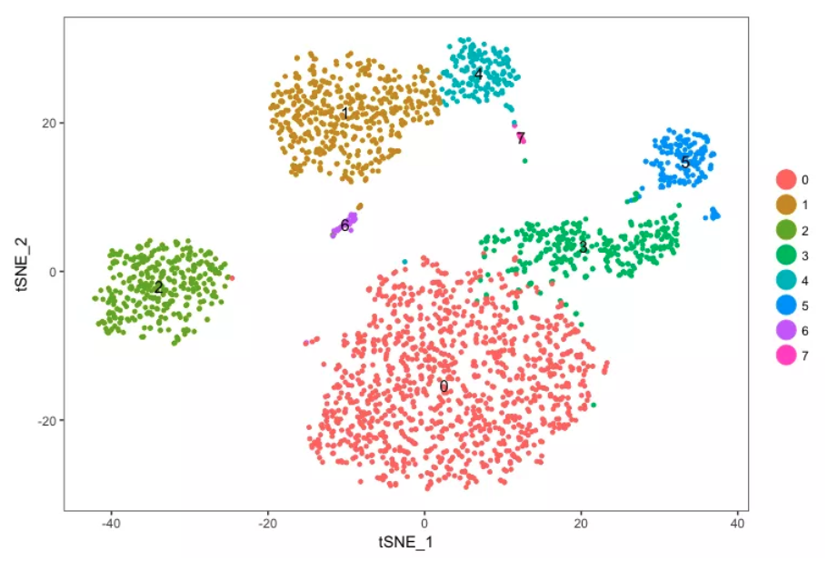
https://davetang.org/muse/2017/08/01/getting-started-seurat/

Slide 8
Measuring What Matters
With the goal to bring the patient into their health care:
  what should be measured?
  when and how often?
  who decides?

Slide 9
If you want to know
how your patients are doing…..
Just ask them

Slide 10


Slide 11
What is PROMIS®?
Patient-Reported Outcomes Measurement Information System®
Measures used to evaluate and monitor physical, mental, and social health (adult & pediatric)
Based in Item Response Theory (IRT)
  Unidimensional
Agnostic to disease or setting
  Suitable for clinical research-trials-care
Developed and evaluated using state-of-the science psychometric methods
Scores on one (T score) metric
Translations available in Spanish & other languages
HealthMeasures.net/PROMIS

Slide 12
Essential Components of PROMIS
DOMAIN
The feeling, function, or perception you wish to measure
Cuts across different diseases and settings. E.g., physical function, depressive symptoms
ITEM BANK
Collection of items that each measure the same domain
Used to create different measure types, all producing a score on the same metric
HealthMeasures.net/PROMIS

Slide 13
PROMIS Measure Types
SHORT FORMS
COMPUTER ADAPTIVE TESTS (CATs)
PROFILES
Collection of short forms covering multiple domains (e.g. depression, physical function, pain interference)
Subsets of item banks
Usually 4-10 items
Individually tailored electronic questionnaires
Next item administered from item bank depends on previous answers
Usually 4-12 items
Adult profiles (29, 43, and 57 item versions), Pediatric and Parent-Proxy profiles (25, 37, 49 item versions)
Focused on a
single domain
Focused on a
single domain
Off-the-shelf
or custom
HealthMeasures.net/PROMIS

Slide 14
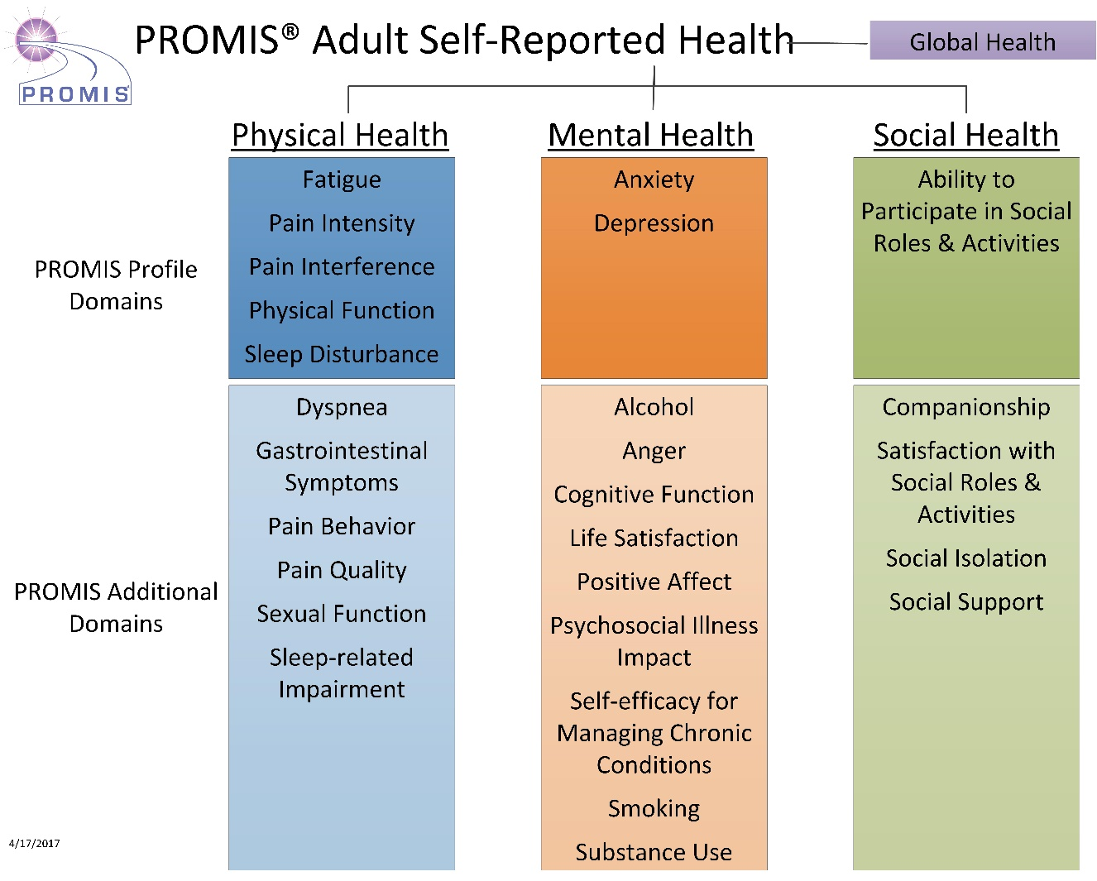
Domains for Adult Assessment
HealthMeasures.net/PROMIS

Slide 15
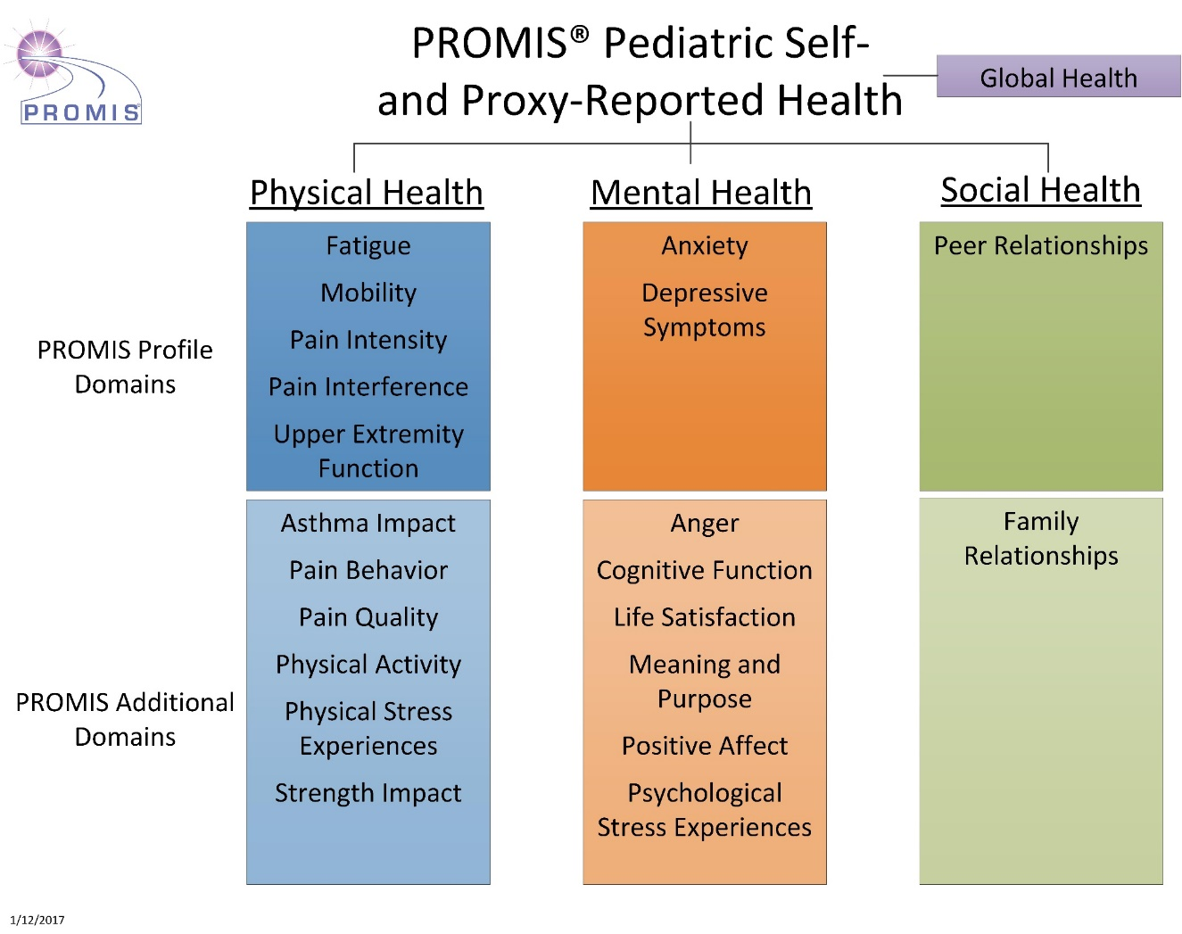
Domains for Pediatric Assessment
HealthMeasures.net/PROMIS

Slide 16
The PROMIS metric
50 = mean for the US population
standard deviation = 10
20 30 40 50 60 70 80
20 30 40 50 60 70 80
68%
95%
99.7%

Slide 17
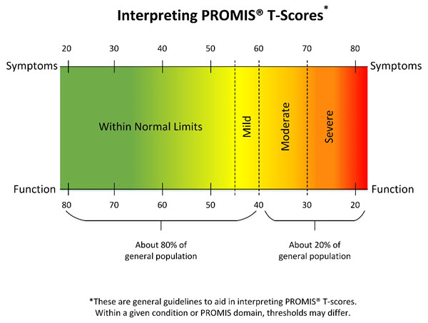
PROMIS Score Ranges
HealthMeasures.net/PROMIS

Slide 18




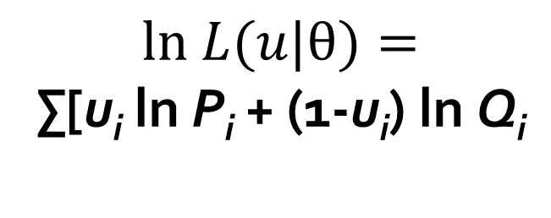



Low
High

Slide 19
Physical Functioning: Improved Precision vs. Legacy
P
r
e
c
i
s
i
o
n
↓
reliability = 0.90
SE = 0.32
Standard error
reliability = 0.95
SE = 0.22
SF-36
rheumatoid arthritis patients
normed theta values
10 item PROMIS CAT
High physical functioning
Disabled
US General Population mean

Slide 20
Domain Definitions: Pain
Pain is an unpleasant sensory and emotional experience
associated with actual or potential tissue damage, or
described in terms of such damage. Pain is what the
patient says it is-that is the ‘gold standard’ of pain
assessment is self-report. Pain is divided conceptually into
components of quality (e.g. the nature, characteristics,
intensity, frequency and duration of pain), behaviors (e.g.
verbal and nonverbal actions that communicate pain to
others) and interference (e.g. impact of pain on physical,
mental and social activities).
www.nihpromis.org

Slide 21
PROMIS Pain Measures
Available to view and download at HealthMeasures.net
DOMAIN/ DEFINITION | ADULT |  | PEDIATRIC |  | PARENT PROXY FOR PEDIATRIC PATIENTS
 | Bank/Scale (# of items) | Short Forms (# of items) | Bank/Scale (# of items) | Short Forms (# of items) | Bank/Scale (# of items) | Short Forms (# of items)
PAIN INTERFERENCE
Consequences of pain on relevant aspects of one’s life | 40 | 4, 6a, 6b, 8 | 20 | 8 | 13 | 8
PAIN BEHAVIOR
Behaviors that typically indicate to others that an individual is experiencing pain | 39 | 7 | 47 | 8 | 51 | 8
PAIN QUALITY
Adult PROMIS Pain Quality scales assess self-reported neuropathic and nociceptive pain: Adult Pain Quality - Neuropathic Adult Pain Quality - Nociceptive Pediatric Pain Quality measures assess specific physical sensations and affective components associated with pain: Pediatric Pain Quality - Bank Pediatric Pain Quality – Affective Pediatric Pain Quality - Sensory | 5 5 |  | 56 | 8 8 | N/A | N/A
PAIN INTENSITY
PROMIS Pain Intensity assesses how much a person hurts. Can be administered in adults as a 3-item scale Can be administered as a 1-item scale in adults, pediatric and parent proxy measures or PROMIS Profile* measures for adult, pediatric and parent proxy administration. |  | 3-item scale 1-item numeric rating scale |  | 1-item numeric rating scale |  | 1-item numeric rating scale
*PROMIS Profiles assess 29-, 43-, 57- items (adult) or 25-, 37-, 49 items (pediatric, parent proxy) on 7 additional domains (e.g. fatigue, depression, anxiety, etc.)

Slide 22
PROMIS® and NIH Toolbox®
Access | Options | Measurement System | Pricing
Healthmeasures.net | PDFs of Static Forms in English; Scoring Manuals; Information on measures, scoring, and community resources | PROMIS NIH Toolbox Neuro-QoL ASCQ-Me | Free
AssessmentCenter.net | All short forms and CATs for web-based administration | PROMIS Neuro-QoL | $5,000/year/study
API | Most CATs, short forms of Self and Proxy reported measures | PROMIS NIH Toolbox Neuro-QoL ASCQ-Me | Annual license fee per quote
iPad Apps | NIH Toolbox and PROMIS branded apps – each with the same measures, just different defaults | PROMIS NIH Toolbox Neuro-QoL SCI-QOL SCI-FI TBI-QoL | $499/year annual subscription (for up to 10 iPads) (Available in English and Spanish for two different annual subscriptions)
REDCap at 1,600 institutions | Most CATs and Short Forms | PROMIS Neuro-QoL | Free
Epic | Initialy CATs and some Short forms - , with commitment to add over 400 HealthMeasures | PROMIS, Neuro-Qol, NIH Toolbox Emotion and ASCQ-Me | Epic charges fixed fee depending on institution size app $5,000-$15,000/year
Department of Defense – growing number of clinics | Some PROMIS CATs | PROMIS | Free for DOD installations

Slide 23
ACR 20 responder index
> 20% improvement in swollen and tender joint count…….plus...
> 20 % improvement in 3 of following 5:
    patient global
    physician global
    patient pain (VAS)
    modified HAQ
    acute phase reactant (CRP or ESR)

Slide 24
‘Improved’ ACR 20 responder index
> 20% improvement in swollen and tender joint count…….plus...
> 20 % improvement in 3 of following 5:
    patient global
    physician global
    PROMIS Pain Index
      intensity, interference, behavior, quality
    PROMIS Physical Function
    acute phase reactant (CRP or ESR)

Slide 25
Rheumatologic PRO responder index
% improvement in the following:
    Pain (intensity, interference, behavior, quality)
    Sleep
    Fatigue
      TNFα inhibitors work centrally vs. peripherally
    Physical function
    Depression
      -High prevalence of suicide attempts among arthritis patients
    GI symptoms
    Sexual functioning
      Many patients with RA experience sexual dysfunction
    Social functioning
Turn the burden around
  Patients (and their HCPs) pick the PROs
Reflects on disease mechanisms (common/distinct)

Slide 26

Validated Outcomes In Clinical Experience
University of Rochester VOICE
Every Patient, Every Clinic, Every Visit

Slide 27

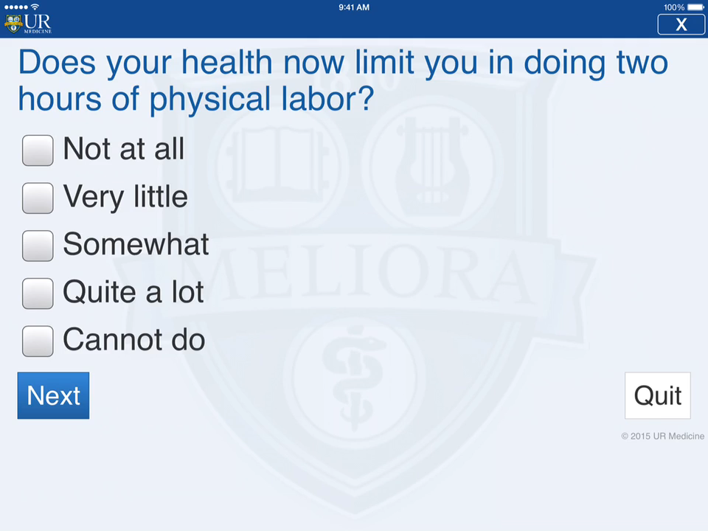


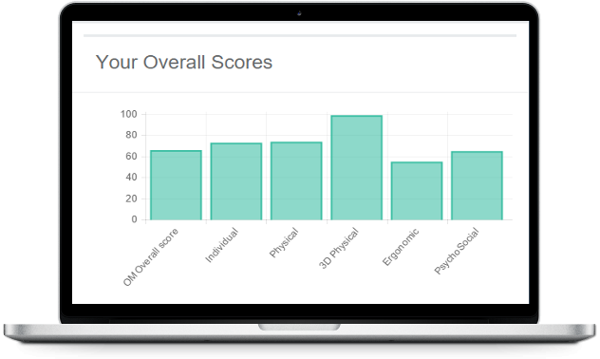
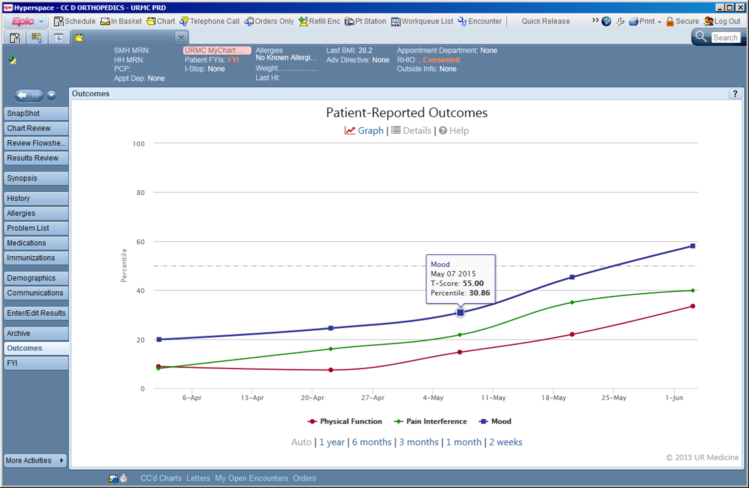

UR VOICE: Validated Outcomes In Clinical Experience
Putting it all together
Scheduling
HL7
Registration
PROMIS
PRO
Package Prep
CORE
Modeling
Predictive Modeling
HTML
Example: Factors influencing the need for rehab stay after TJA (PROMIS PF scores, co-morbidities, pharma, prior surgery etc.)
Interactive
Visualization
Epic Hyperspace
Epic Interconnect Server
Epic Chronicles
Integration

Slide 28
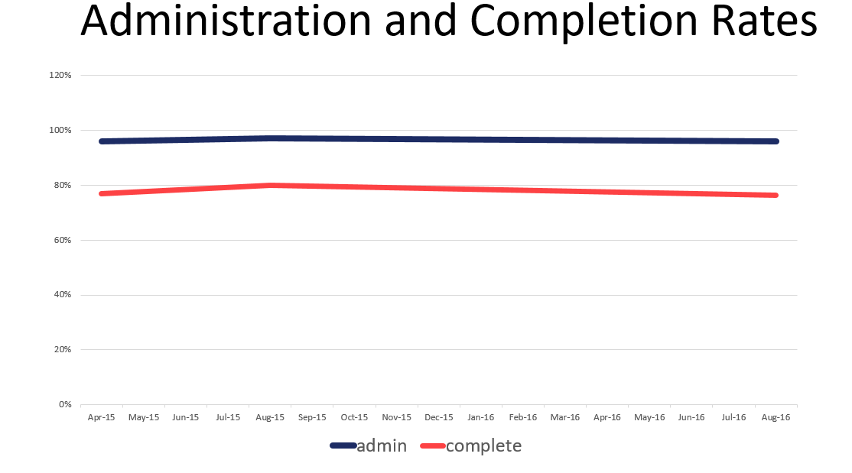

Slide 29
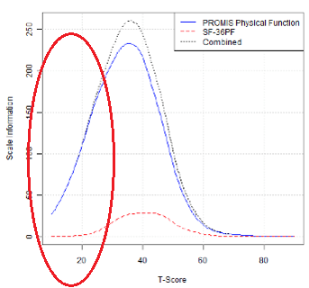

Slide 30

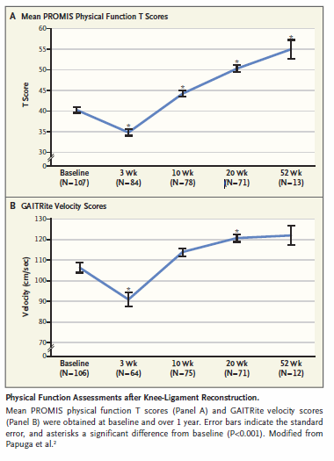
Link to paper

Slide 31



Save the Dates
Sunday, October 23 &
Monday, October 24, 2016
(Following ISOQOL)
Radisson Blu Hotel Scandinavia
COPENHAGEN, DENMARK
PROMIS®: Measuring Health Outcomes
Around the World
Complete abstract and registration information available at
www.regonline.com/pho2016conference

Slide 32
Common Resource To Advance Patient-Centered Outcomes
Patient Centered
Longitudinal-quantitative
  NIH studies
  PCORI funded
  Industry studies
  National surveys
  Clinical care
Web based follow-up
Fully test domain
Clinically focused testing
Psychometrically focused testing
Patient Centered
Cross Sectional
  Cognitive testing
  Focus groups
Fully develop domain

Slide 33


Slide 34

At a national level, study and validate child Patient Reported Outcomes (cPROs) with nationally-derived pediatric standards (i.e. PROMIS measures)
Occur in a variety of chronic pediatric diseases/conditions in a variety of clinical settings
Help understand the impact of ecosocial and psychosocial factors as environmental stressors

Slide 35
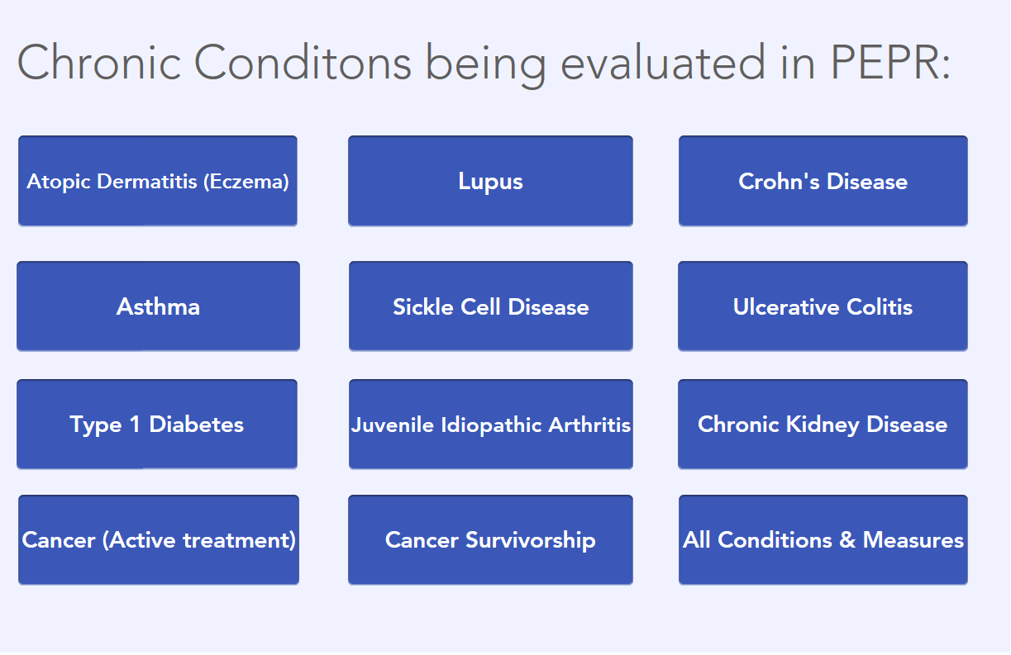

Slide 36
PROMIS Pediatric Measure | Atopic Dermatitis (Eczema) | Asthma | Type 1 Diabetes | Sickle Cell Disease | Rheumatic Disease (JIA, SLE) | IBD Crohn's / UC | Chronic Kidney Disease | Cancer (Active) | Cancer (Survivors)
Asthma Impact |  | MCW, NU
Global Health | NU | MCW*, NU | MCW* | MCW* |  | CHOP*
Anxiety | NU | MCW, NU | MCW | MCW | Duke | Duke |  | Duke | CHOP
Depression | NU | MCW, NU | MCW | MCW | Duke | Duke |  | Duke | CHOP
Positive Affect |  |  |  |  |  | CHOP |  |  | CHOP
Life Satisfaction |  |  |  |  |  |  | CHOP
Meaning & Purpose |  |  |  |  | Duke |  |  |  | CHOP
Psychological Stress Experiences | NU | NU |  |  | Duke |  | CHOP | Duke | CHOP
Physical Stress Experiences |  | MCW | MCW | MCW
Pain Interference | NU | MCW, NU | MCW | MCW | Duke | CHOP, Duke |  | Duke | CHOP
Pain Behavior |  | MCW | MCW | MCW
Pain Quality |  | MCW | MCW | MCW
Pain Intensity* | NU | MCW, NU
Fatigue | NU | MCW, NU | MCW | MCW | Duke | CHOP, Duke | CHOP | Duke | CHOP
Family Relationships |  | MCW | MCW | MCW | Duke
Peer Relationships | NU | MCW, NU | MCW | MCW | Duke | Duke
Physical Functioning | NU | MCW, NU | MCW | MCW | Duke |  |  | Duke
Physical Activity |  | MCW, NU | MCW | MCW | Duke |  |  | Duke
Strength Impact |  | MCW | MCW | MCW
Itch (developing) | NU
Sleep Disturbance (new) | NU |  |  |  |  |  | CHOP
Stigma (new) | NU |  |  |  |  |  |  |  | CHOP
IBD GI Symptoms (new) |  |  |  |  |  | CHOP
*1 item measure
NU=Northwestern University MCW=Medical College Wisconsin Duke=Duke University CHOP=Children's Hospital of Philadelphia

Slide 37

https://zoom.us/recording/play/vmOQRvpme26mmT9LUWJW4Qa3tY_uc0-oXjaM98tpq-jZnNSdwPXSprBKjJQ379wD

Slide 38
PROMIS & FDA Qualification
Fatigue
  Adult rheumatoid arthritis (RA)
  Adult ME/CFS
  Pediatric chronic kidney disease (CKD)
Pain
  Pediatric Crohn’s disease: Pain Interference
Physical Function (adult)
  Sarcopenia
  RA (future)

Slide 39
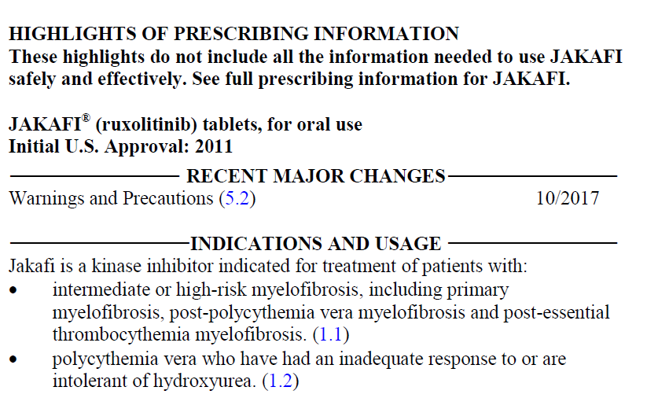
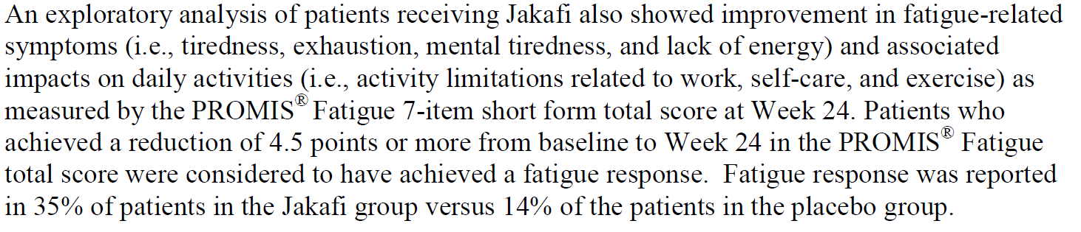

Slide 40


Slide 41
Goals of ECHO
Understand effects of early environmental exposures on child health and development
  Effects: Understood by observation (& intervention)
  Early: conception to age 5
  Environmental exposures: society to biology
    Air pollution
    Chemicals in our neighborhoods
    Stress
    Social networks
    Behavior—sleep, diet, etc.
    Biology—epigenetics, microbiota, etc.
  Child health and development
    High-impact conditions: 4 focus areas
      Pre/peri/post-natal outcomes
      Upper and lower airway
      Obesity
      Neurodevelopment

Slide 42


Slide 43
Positive Health Differs from “Quality of Life”
Quality of life (QoL) measures primarily focus on
  symptom burden and “problems” associated with
  physical, emotional, and social functioning
By contrast, Positive Health focuses on
strengths or health assets … “well-being”
Notes:
Traditional views of QOL, and certainly HEALTH-related QOL (HRQOL), focus on …
? Relation to activities of daily living (ADLs)

Slide 44
The Positive Health Approach
  Health as a spectrum, with health resources that are challenges (-) or strengths (+).
Challenges
Health Resources
Strengths
Disorders, illness, impairments
Assets
Notes:
PH recognizes health as a spectrum, with both positive and negative valences.

Slide 45
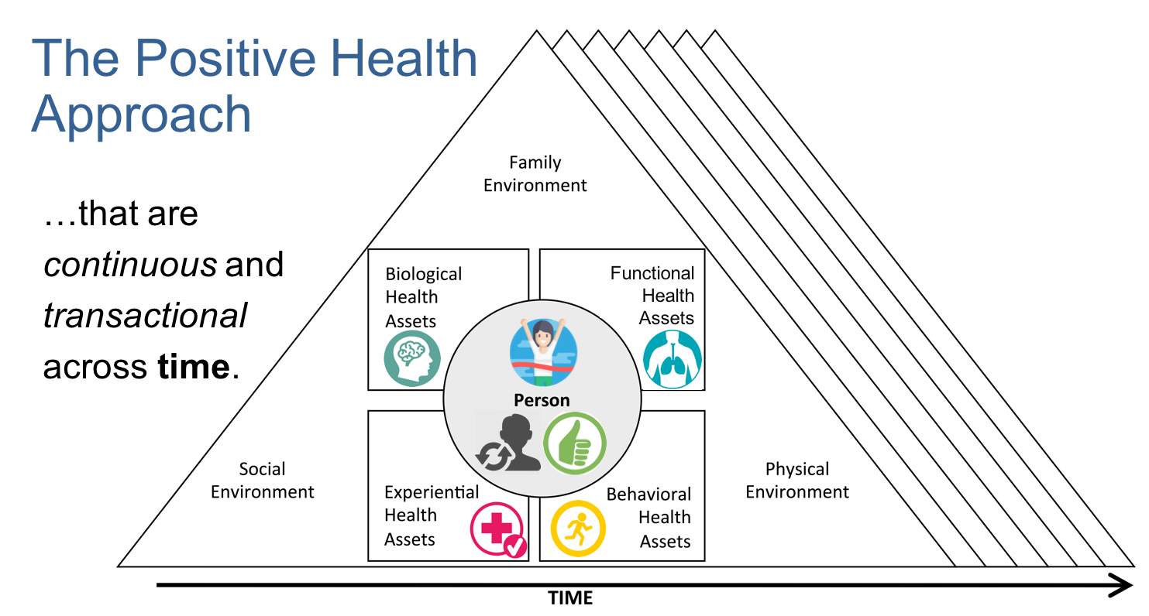
Advancing the Science of Children's Positive Health in the National Institutes of Health Environmental Influences on Child Health Outcomes (ECHO) Research Program
Journal of Pediatrics vol. 196, p. 298-300; 2018

Slide 46
NIAMS Clinical Research/Trial Opportunities
Implementation
Clinical Trial
Implementation
(U01) PAR-18-594
Ancillary Mechanistic Studies to Ongoing Clinical Projects
(R01 CT Not Allowed)
RFA-AR-19-006
Mechanistic Trials
(Parent R01/R21)
PA-18-345 PA-18-344
Clinical Trial
Planning (R34)
PAR-16-446
Ancillary Mechanistic Studies to Ongoing Clinical Projects
(R21 CT Not Allowed)
RFA-AR-19-007
Exploratory
Clinical Trials (R21)
PAR-18-595
Clinical
Observational Studies (R01)
PAR-18-597
Early
Development
NIAMS Clinical Research Webpage

Slide 47
NIAMS Clinical Research/Trial Program Summary
Study Type | Mechanism | Budget Caps (Direct Cost) | Scientific Review | Special Considerations
Clinical Observational PAR-18-597 | R01 | $450K in direct costs over 3 years No more than $225K in any single year | NIAMS (AMSC) | Only for non-interventional studies that collect data to inform / enhance subsequent future trials; Clinical trials not allowed
Exploratory PAR-18-595 | R21 | $400K in direct costs over 3 years | NIAMS (AMSC) | Designed to facilitate the execution of short-term, interventional studies; Clinical trial required
Planning PAR-16-446 | R34 | $300K in direct costs over a period of up to 2 years | NIAMS (AMSC) | No human subjects enrollment allowable
Implementation PAR-18-594 | U01 | No budget cap^^, up to 5 years | NIAMS (AMSC) | Planning and administrative activities must be complete prior to seeking U01 funding; Clinical trial required
Mechanistic Ancillary RFA-AR-19-006 | R01 | $300K in direct costs per year for up to 4 years | NIAMS (SEP) | Study must be time sensitive and leverage an existing resource
Mechanistic Ancillary RFA-AR-19-007 | R21 | $400K in direct costs over 2 year period No more than $250K/year in direct costs up to 2 years | NIAMS (SEP) | Study must be time sensitive and leverage an existing resource
Mechanistic Studies PA-18-345 | Parent R01 | No budget cap^, up to 5 years | CSR | Primary objective is mechanistic rather than a clinical outcome; Clinical trial required
Mechanistic Studies PA-18-344 | Parent R21 | $275K*in direct costs over 2 years | CSR | Primary objective is mechanistic rather than a clinical outcome; Clinical trial required
^^ Applications requesting ≥ $500K in direct costs in any year (excluding consortium F&A) requires approval prior to submission (10 weeks prior)
*The combined budget for direct costs for the two-year project period may not exceed $275,000. No more than $200,000 may be requested in any single year
^Application budgets are not limited but need to reflect the actual needs of the project. The scope should determine the project period. The maximum project period is 5 years.

